Slide 1
Belbin roles etc.

Slide 2
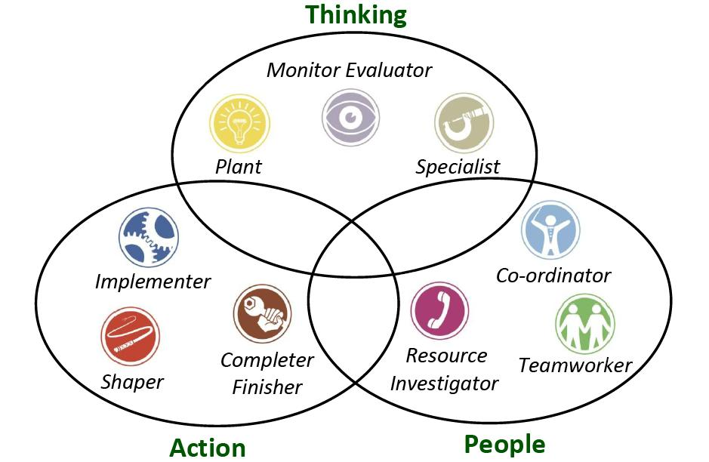

Slide 3
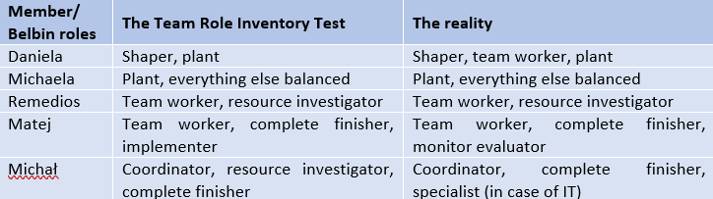

Slide 4
Gather ideas and formulate the main goals and overall structure together,
Divide the work for groups consisting of 1-3 persons,
Having everything checked by everyone, i.e. leaving feedback and discussing about individual parts.
Using technical tools to help us working in group

Slide 5


Slide 6
